Slide 1

Credit Card Approval Prediction
Suryansh Mishra

Slide 2
Business Problem and Dataset
We aim to predict credit card approval based on applicant data. Each row is a unique person applying for approval.
The dataset includes demographics, financial history, employment, and ownership data.
The business goal is to identify key drivers of approval and build a powerful model to automate the approval process.
Notes:
Include Slide Numbers

Slide 3
Initial Data Exploration
Key columns: Gender, Age, Total Income, Job Title, Education Type, and Debts.
Applicants with higher income and longer working years have higher approval rates.
Certain job types and housing status also correlate with approval likelihood.

Slide 4
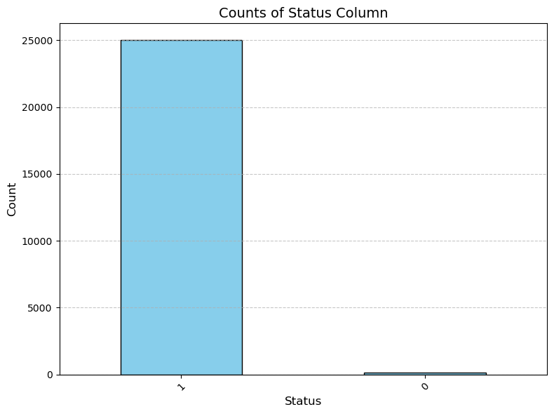
Target Variable Distribution
99.5% of Rows are Classified as Class 1 or Credit Approved
.5% of Rows are Classified as Class 0 or Credit Not Approved

Slide 5
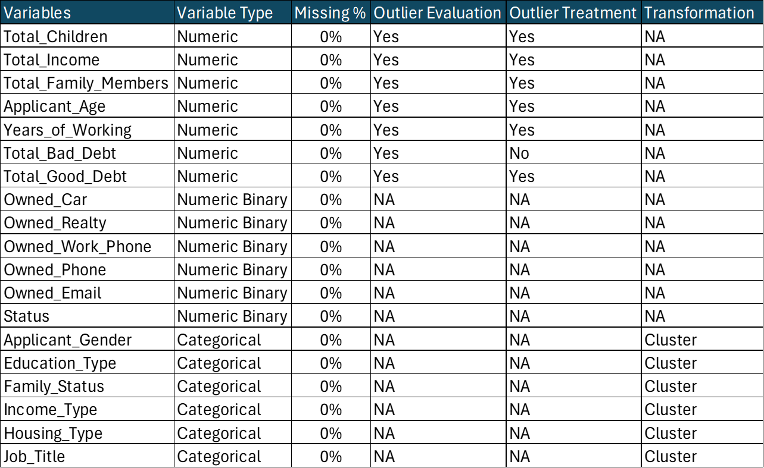
Variable Preparation and Evaluation Points
Notes:
We evaluated data completeness in terms of missing observations and evaluated for outliers.
Outliers were reviewed with visual tools and adjusted case by case.
All other models besides Naive Bayes can use continuous variables and not Binned – How did we calculate the clusters? Was it actual clustering or just data reduction? Might not be actual clustering
Categorical variables were grouped into clusters based on their relationship with approval outcomes.
Continuous variables like income and age were binned to handle non-linear patterns.
All categorical data was one-hot encoded to prepare it for machine learning models.

Slide 6
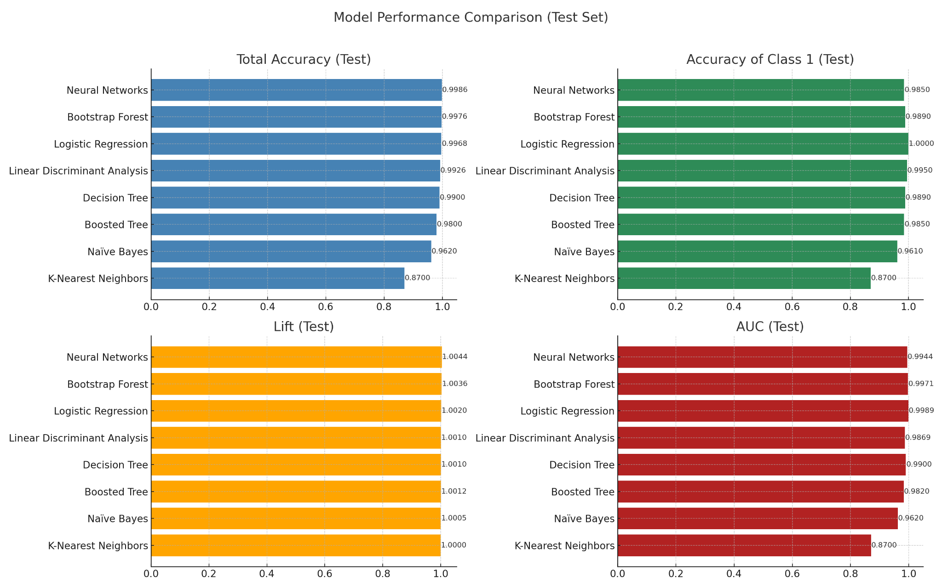
Model Performance Comparison

Slide 7




Important Variables and Trends
- Total Bad Debt and Good Debt are first decision node splits in Decision Tree
- Total Good Debt is 40% of absolute weight in Neural Network
- Job title and education cluster also show predictive value with 20% absolute weight in Neural Network
- Class imbalance observed: approvals are majority class at 99% of total data
Notes:
Have more data behind these? Show why we think its important.. Didnt show bad debt and good debt.. Neural Network also shows good and bad debt.

Slide 8
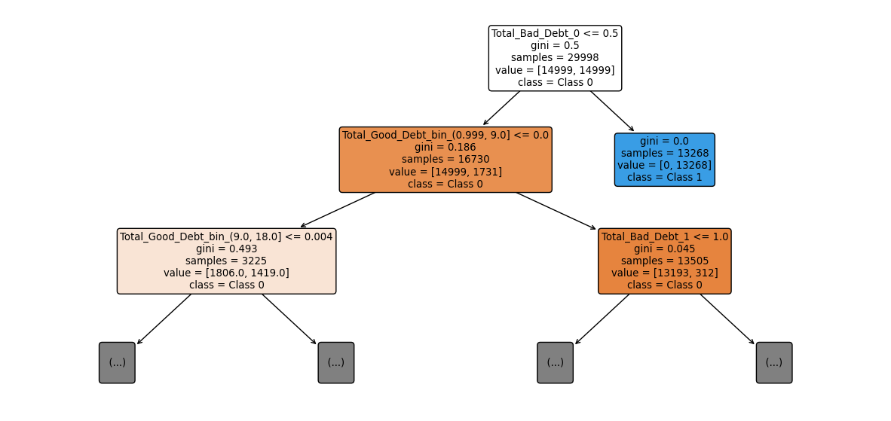
Decision Tree Used to Help Determine Variable Importance
Most Splits related to Bad Debt and Good Debt with various thresholds.

Slide 9
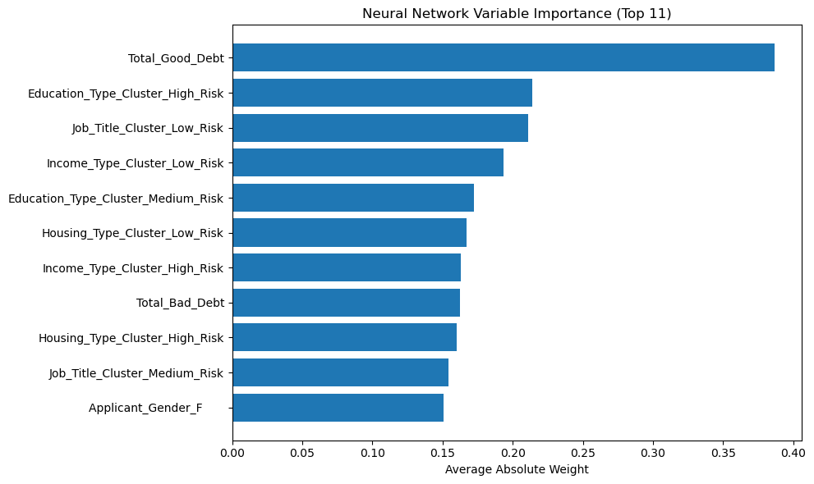
Variable Importance: Neural Networks
Below chart based on average absolute weights in the first hidden layer
Top variables: Total Good Debt, Education Type, Job Title, and Total Debt.

Slide 10
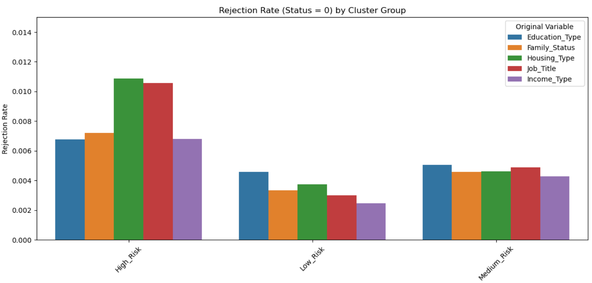
Variable Transformations
Cardinality of categorical variables were reduced by creating cluster variables.
Reduce Noise and Overfitting
Enhances Interpretability
Notes:
We chose Neural Networks because performance stayed consistent across training, validation, and test sets.
It handles complex, nonlinear relationships; especially useful after we clustered some variables, which reduced transparency.
It's also adaptive. If we get new data, the model can be retrained easily, even when we don't have clear patterns for no approval cases.

Slide 11
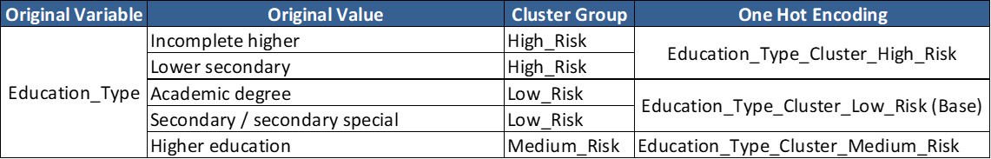
Variable Transformation Mappings
The table provides an example of the original variable, the cluster variable and the new binary variables created using one-hot encoding.
High Risk cluster is composed of “Incomplete Higher Education” and “Lower Secondary Education” which follows economic intuition since people with lower education background tend to perceive lower income.
Low Risk cluster is composed of “Academic Degree” and “Secondary Special” which also follows economic and business intuition since people with higher education tends to perceive higher income.

Slide 12
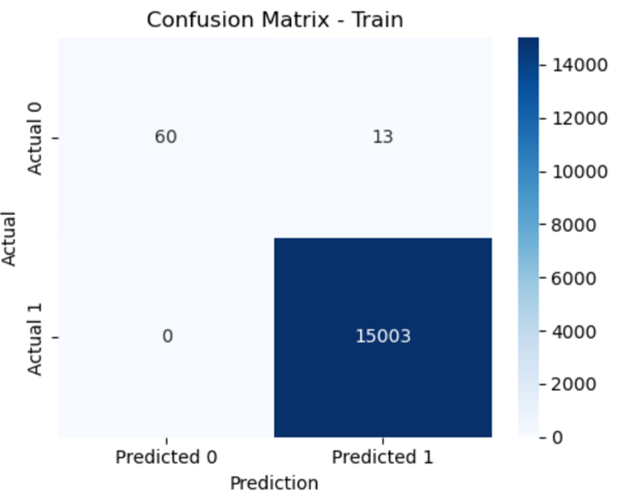
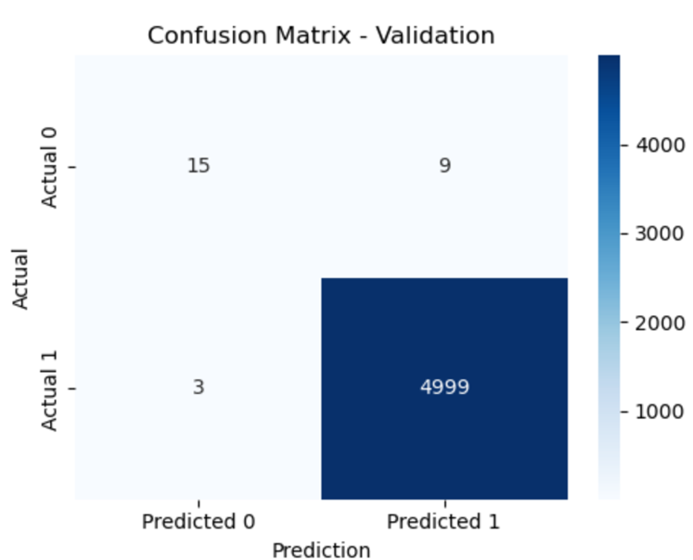
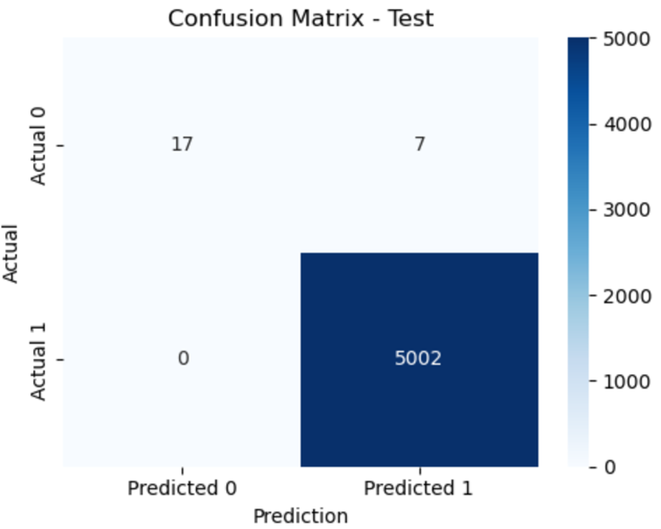
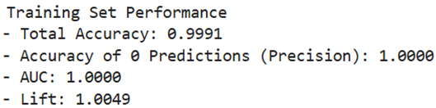
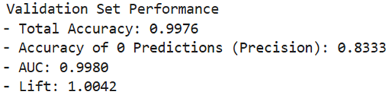
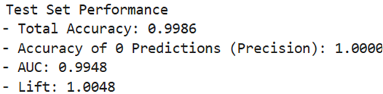
Best Fit Model: Neural Network
No performance drop across partitions
Best performance for Class 0.
Captures complex relationships from clustered predictors
Can auto-train with new data, fits business use case

Slide 13
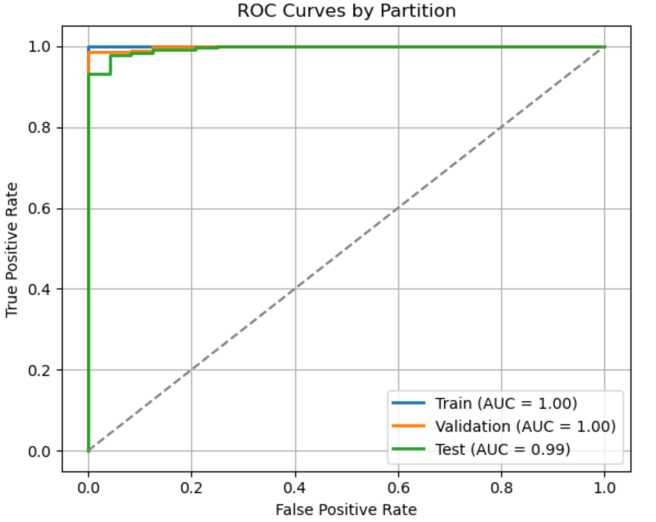
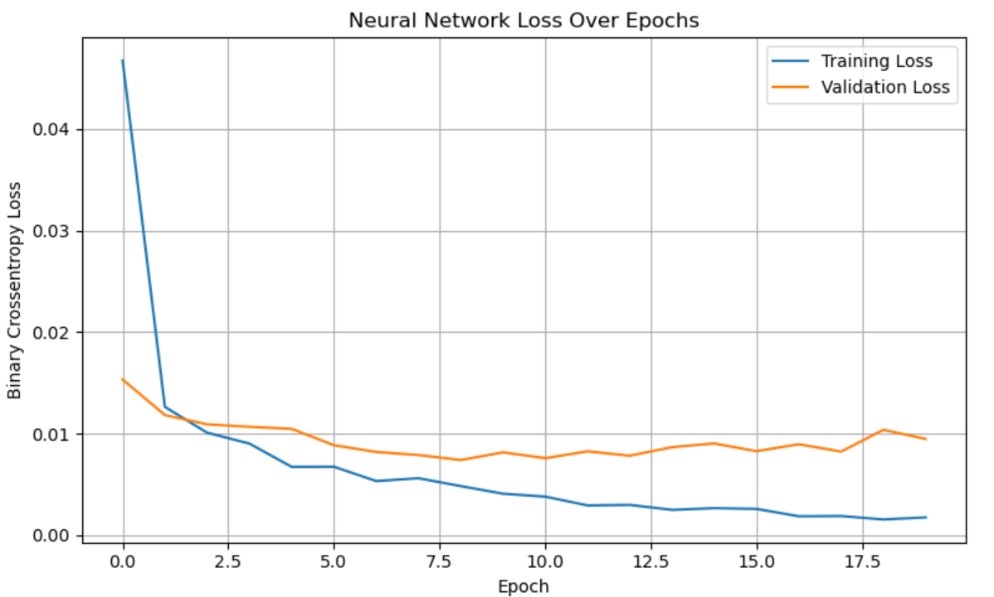
Best Fit Model: Neural Network (cont’d)
ROC suggest perfect model fit likely to be influence by the imbalance data.
The Loss Curve suggest the model learns at a fast rate in the early stages
Training Loss decreases smoothly and flattens out towards the end
The Validation Loss decreases at the beginning and slightly increases towards the end which suggest the model may be capturing some noise
The gap between training and validation loss is moderate
Notes:
We chose Neural Networks because performance stayed consistent across training, validation, and test sets.
It handles complex, nonlinear relationships; especially useful after we clustered some variables, which reduced transparency.
It's also adaptive. If we get new data, the model can be retrained easily, even when we don't have clear patterns for no approval cases.

Slide 14

Python vs JMP Findings
One-Hot Encoding: Converts categories into binary columns to make data machine readable.
SMOTE: Generates synthetic examples by interpolating similar minority cases, not just duplicating rows.
Data Type Sensitivity: Python models require manual type conversion, no auto detection like in JMP.
Model Comparison: In Python, each model must be coded individually, JMP runs all models in one step.
Notes:
One-Hot Encoding: Python technique to convert categorical variables into “dummy” variables. Widens the data by creating additional indicator columns for each category.
Synthetic Minority Over-sampling Technique (SMOTE): Unlike simply duplicating rows, SMOTE leveraged distance-based measures to generate synthetic data by interpolating between closely related rows.
Predictor Data Type Sensitivity: Models that only allow continuous or categorical variables need to be directly converted in python and can’t auto-convert like JMP does.
Model Comparison: Had to write code for all models one by one vs using Model Comparison platform on JMP which will run all models to compare performance.

Slide 15

Business Recommendations
Avoid Targeting High Bad Debt and High Good debt Individuals
Business can target individuals with High Income levels and have a Academic Degree
High Accuracy of Class 1: Can accurately predict approvals at 99%.
Highest accuracy of Class 0: Neural Network can predict No Approval at 87% for new data, much higher than our other models.
Launch into Production: Holding data assumptions true, we can launch the neural network model and feed in new data as it becomes available.
Receive more data: Improve model by collecting data on applicants not approved to balance the dataset.
Human-In-The-Loop: Flag applicants with lower approval probabilities based on predefined high cut-off value in line with business goals.
Notes:
Add something specific to most important variables and how we can take action on that.

Slide 16
References
Dataset: https://www.kaggle.com/datasets/caesarmario/application-data?resource=download&select=Application_Data.csv
SMOTE Article: SMOTE for Imbalanced Classification with Python - MachineLearningMastery.com

Slide 17
Appendix
Notes:
Everything in appendix is used for grading

Slide 18
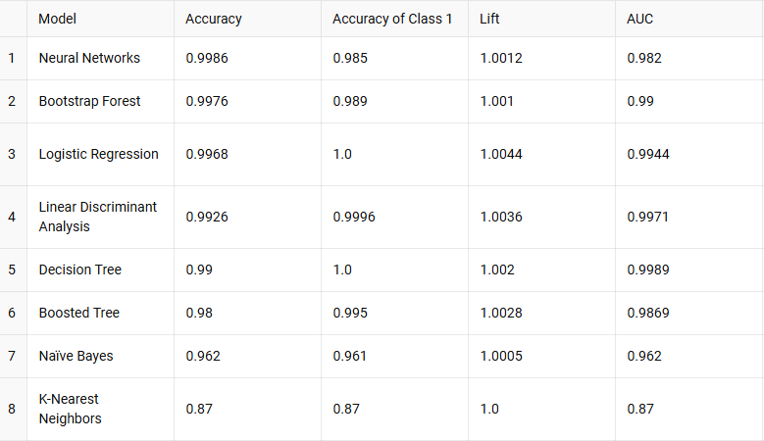
Model Metrics for Test Partitions

Slide 19
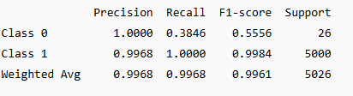
Model: Logistic Regression

Slide 20
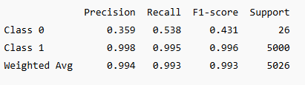
Model: Linear Discriminant Analysis

Slide 21
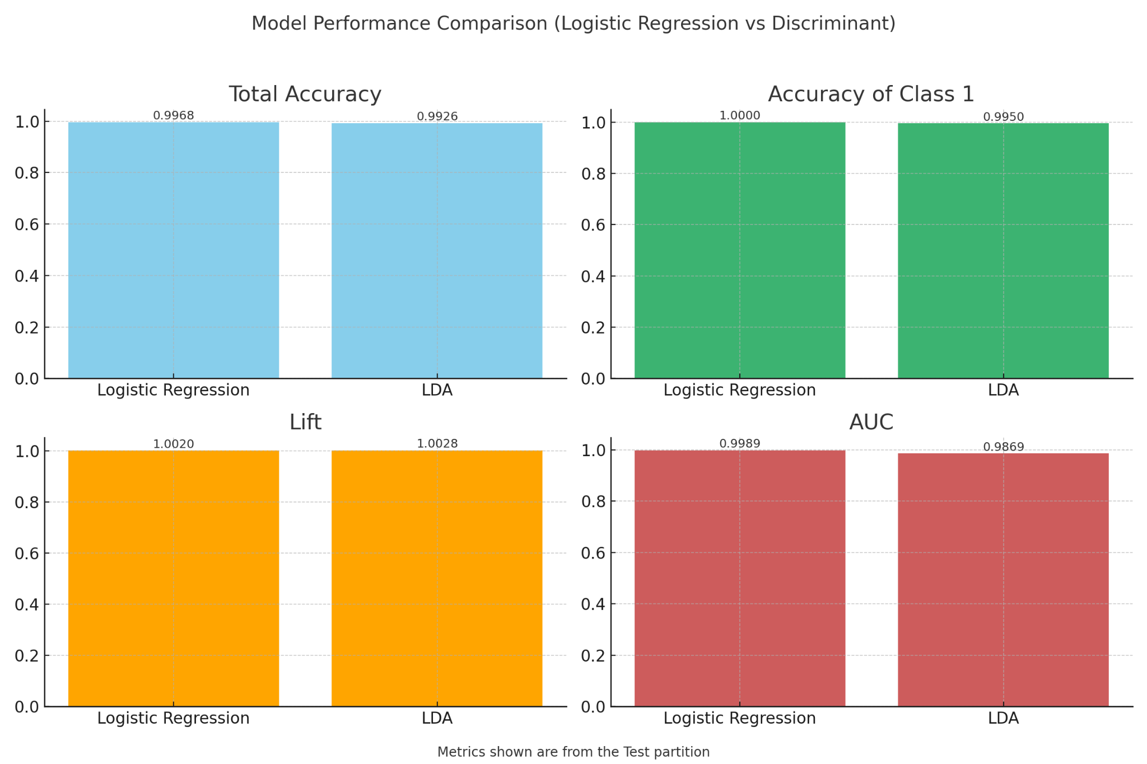
Logistic Regression vs Discriminant

Slide 22
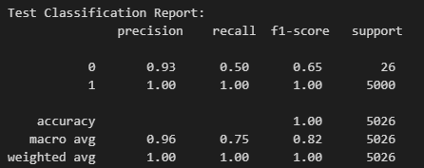
Model: Boosted Tree
High Precision Rates across both classes as most of the data is Positives so less chance of a false positive
Lower recall rate for No Approvals - 50% of class No Approvals are coming back as Approvals (Only 26 records of No Approval)
Lift of 1.0 for all partitions

Slide 23
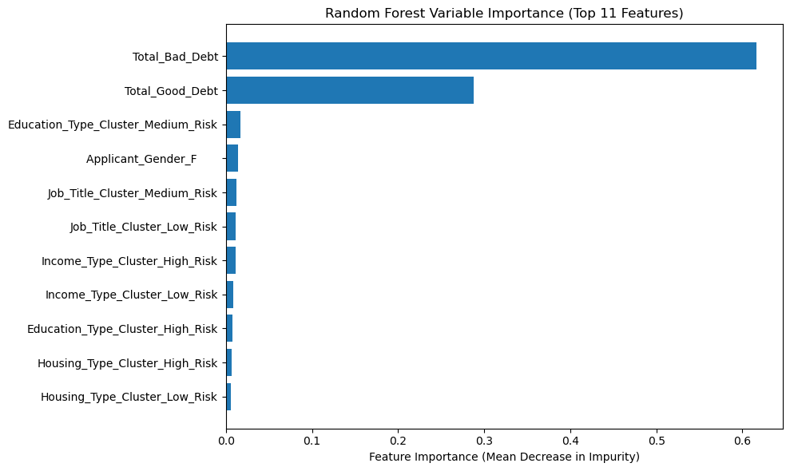
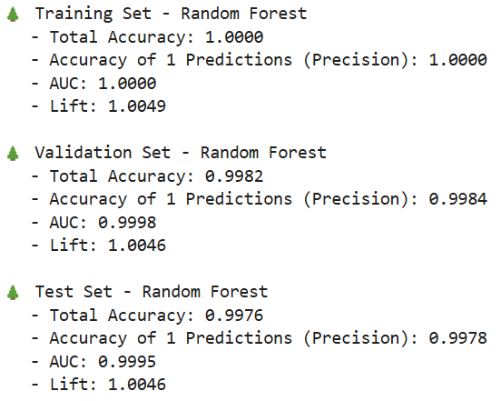
Model: Bootstrap Forest
Variable importance was derived from mean decrease in impurity across all trees .
The main variables are: Total Bad Debt, Total Good Debt while other education type and job title have a lower impact.

Slide 24
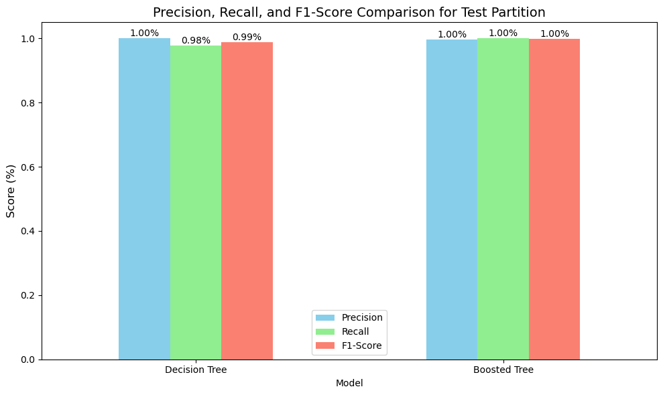
Decision Tree vs Gradient Boosting

Slide 25
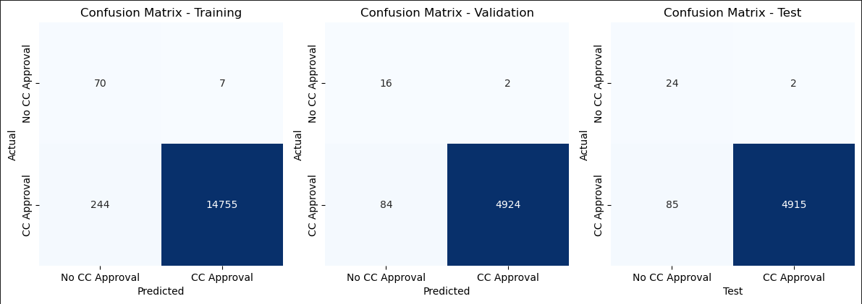
Model: Decision Tree
Kept all Intuitive variables in model to let Tree analyze all of them and split based on important ones.
99% Overall Accuracy in All Partitions.
Accuracy of Rare Event: Training: 22%, Validation: 16%, Testing: 22%
Total Bad Debt was the most important variable in the decision tree splits, Second was Total Good Debt.
Lift: 0.99 across all partitions
Set Max Depth=5 to avoid Overfitting
Set Minimum Samples Split to 10 to avoid small splits of noise

Slide 26

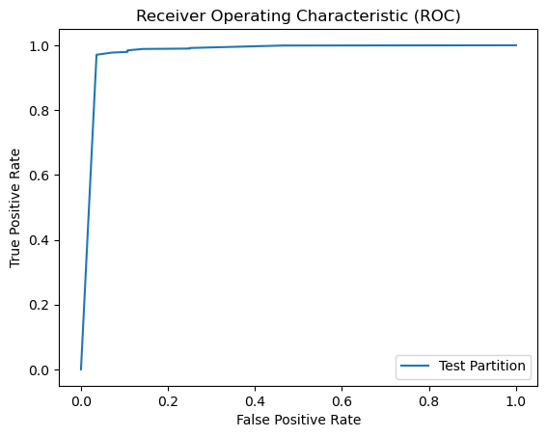
Model: Decision Tree pt 2
Experimented with numerous thresholds but accuracy and other statistics held the same

Slide 27
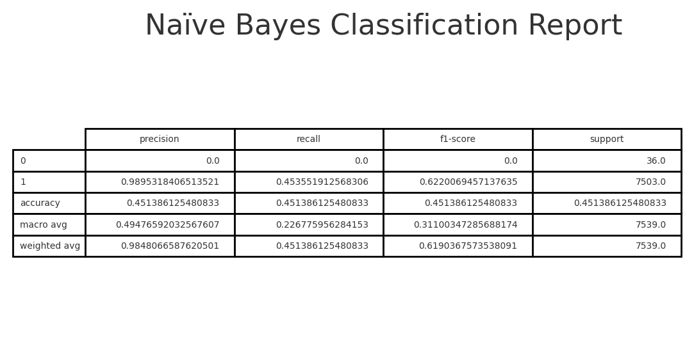
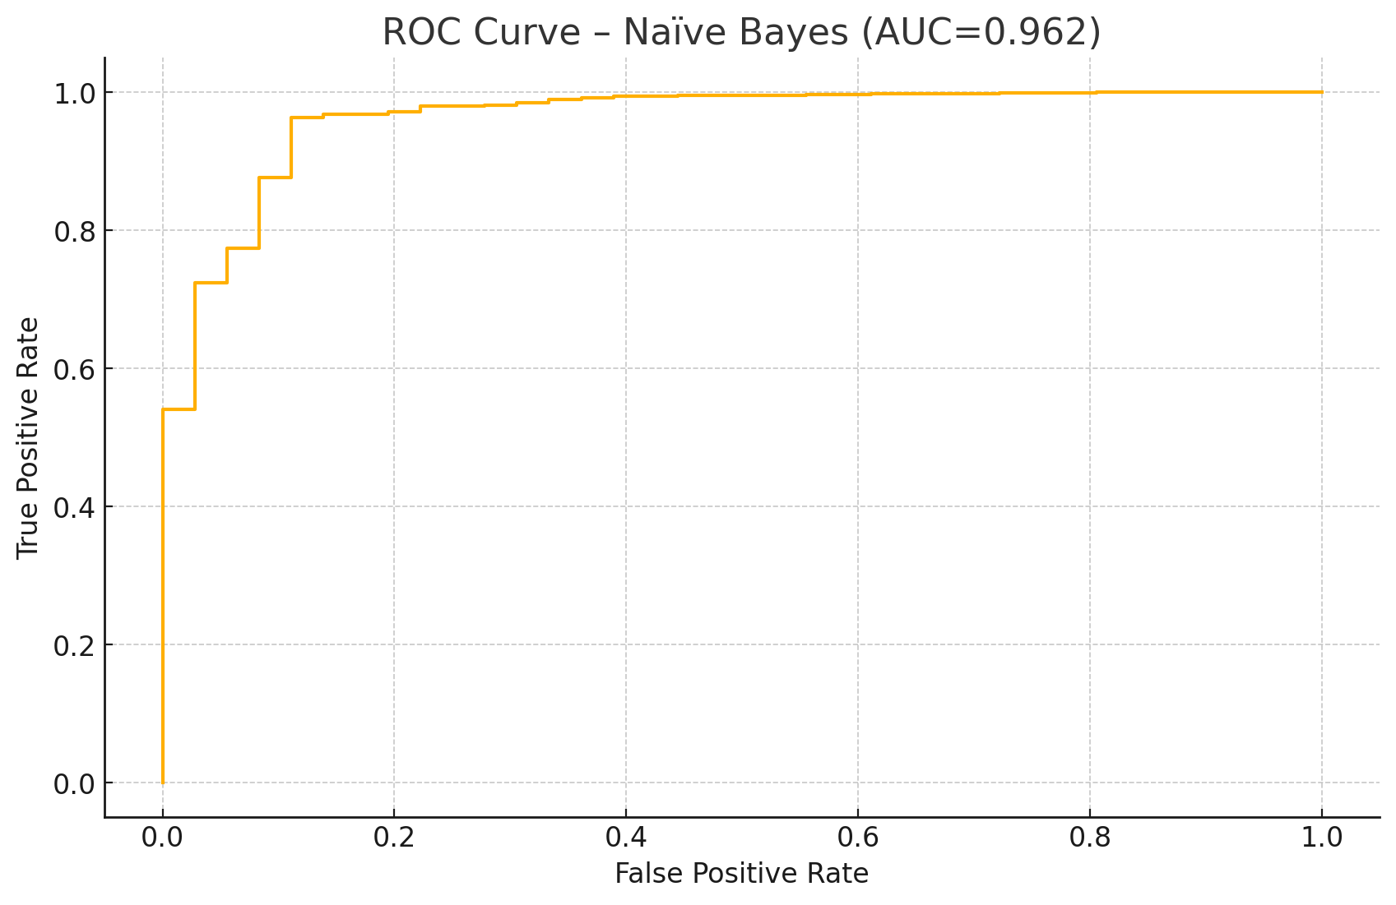
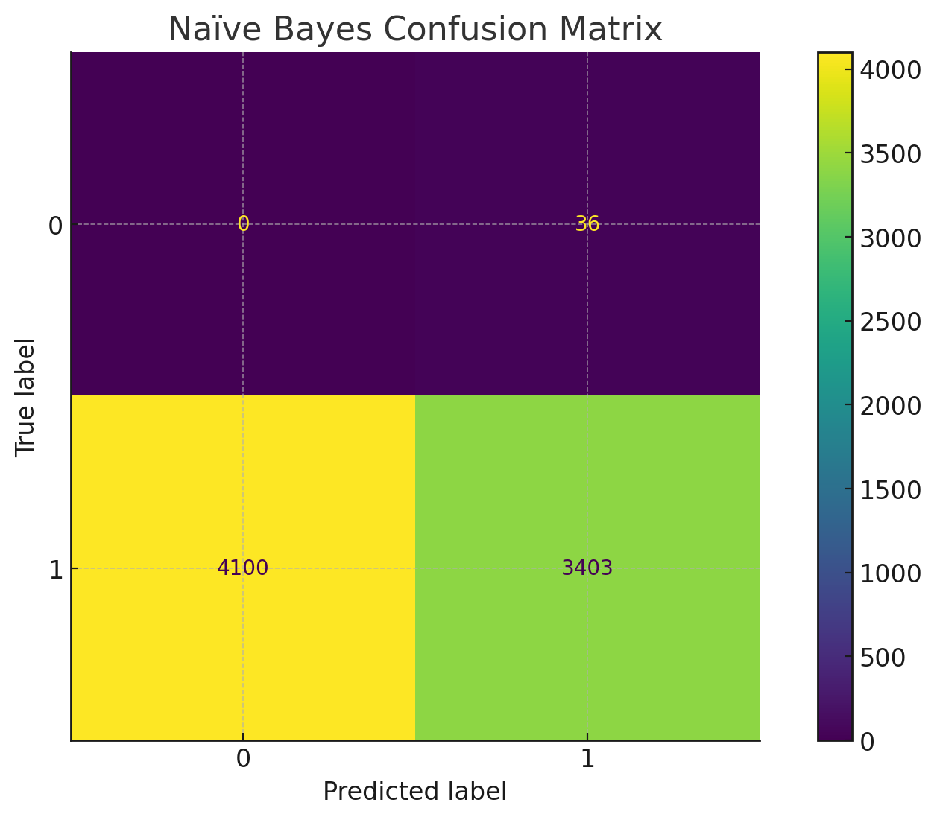
Model: Naïve Bayes
Testing Partition Model Performance:

Slide 28
Naive Bayes Performance
Overall Discrimination (AUC = 0.962): Excellent ability to rank applicants by approval likelihood.
High Precision on Approvals (≈ 99.98 %): When it predicts “Approved,” it’s almost always correct—only 1 false positive out of 4,103 positive predictions.
Strong Recall on Denials (≈ 97 %): Nearly all true “Denied” cases are caught (35/36).
Moderate Recall on Approvals (≈ 55 %): Only about half of actually approved applicants are identified, leading to many false negatives (3,401 of 7,503).
Use Case Insight:
Best where you cannot afford to approve risky applicants (minimize false positives).
Trade‐off is missing some good applicants (higher false negatives).

Slide 29
K-NN Performance
Class Imbalance
Only ~0.5% of samples are “Denied.” As a result, the model “plays it safe” by almost always predicting “Approved,” yielding very high overall accuracy (99.8%) but poor detection of the rare class.
Denied‑Class Performance
Recall = 0.33: Only one‑third of actual denials are caught.
Precision = 0.33: When the model predicts “Denied,” it’s right only one‑third of the time.
F1 = 0.33: Poor balance of precision/recall on denials.
Approved‑Class Performance
Perfect precision and recall (F1 = 1.00), unsurprising given the class prevalence.
ROC Curve
AUC = 0.87 indicates strong overall separability, but the default 0.5 threshold fails to capture the minority class well.

Slide 30
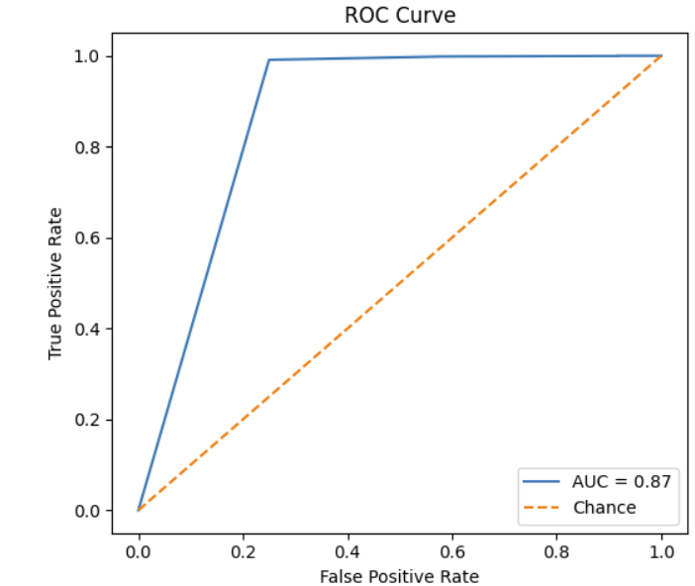
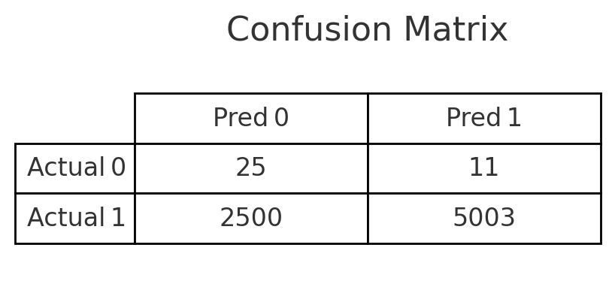
Model: K-Nearest Neighbors

